Slide 1
CPSC3300: Computer Systems Organization
Lectures 23 & 24 – Parallel Processing

Slide 2
Parallelism
Instruction level parallelism (ILP) within a single processor without involvement of programmers
  Pineline and superscalar architecture
  Limitations of ILP
Parallel processing at higher level
  Multithreading
  Multiprocessing

Slide 3
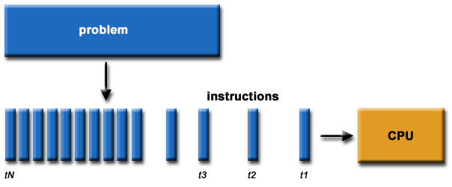
Sequential Computing
software has been written for sequential computation:
  To be run on a single computer having a single Central Processing Unit (CPU);
  A problem is broken into a discrete series of instructions.
  Instructions are executed one after another.

Slide 4
Serial Architecture
Consisting of single processor, memory, datapath
Instruction Level Parallelism
  Pipeline
    Instructions are pipelined
    Only one instruction is issued at each cycle
    Multiple instructions on the pipeline at each cycle
  Superscalar
    Multiple instructions can be issued at a cycle

Slide 5
MIPS Pipeline Example
1
2
3
4
5
6
7
8
9
10
11
12
13
14
15
add $6,$5,$2
lw $7,0($8)
addi $16,$16,10
add $6,$4,$2
sw $7,0($16)
addi $2,$2,4
F
D
E
M
W
F
D
E
M
W
F
D
E
M
W
F
D
E
M
W
F
D
E
M
W
F
D
E
M
W
MIPS: 5cycles/ins, fixed number of stages
6 instructions, 10 cycles with pipelining
30 cycles without pipelining

Slide 6
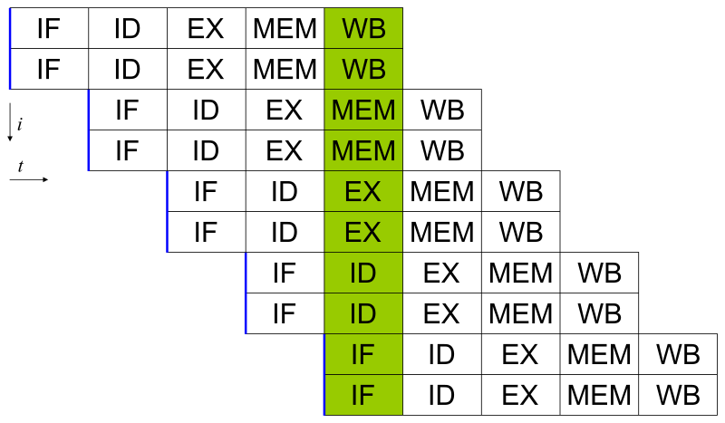
Ideas of Superscalar
simultaneously dispatching multiple instructions to redundant functional units on the processor

Slide 7
Limitations of ILP
Pipeline
  The speed is eventually limited by the slowest stage
  Very deep pipeline (20) to speed up the slowest stage
  Typically every 5-6th instruction is a conditional jump
  The penalty of a branch misprediction grows with the pipeline depth
Superscalar
  Data dependency
  Resource dependency
  Branch dependency
  Complex scheduler
  Great complexity for hardware

Slide 8
Architectures for Parallel Computing
Computing platforms for multithreading
  Single core processor on a single machine
  Multicore processor on a single machine
  Multiple processors on a single machine
Computing platforms for multiprocessing
  Multicore processors on a single computer
  Multiple processors on a single computer
  Clusters with multiple computers, or computer clusters

Slide 9
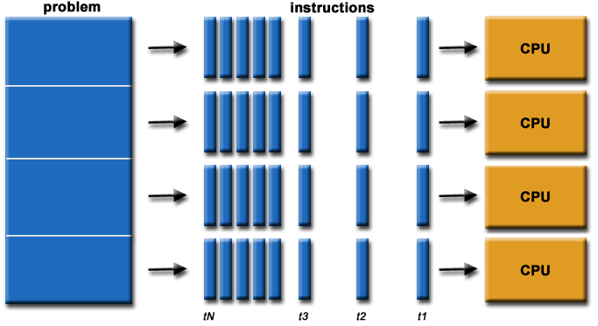
Parallel Computing
Parallel computing is the simultaneous use of multiple compute resources to solve a computational problem.
  Multiple CPUs are used
  A problem is broken into discrete parts that can be solved concurrently
  Each part is further broken down to a series of instructions
  Instructions from each part execute simultaneously on different CPUs
Task-level parallelism: multiple independent problems running on multiple CPUs, each problem forming a series of instructions
Slide <number>

Slide 10
Parallelizable Problems
The computational problem usually demonstrates such characteristics:
  Can be broken apart into discrete pieces of work that can be solved simultaneously;
  Can execute multiple program instructions at any moment in time;
  Can be solved in less time with multiple compute resources than with a single compute resource.

Slide 11
Amdahl’s Law
Execution time of any code has two portions
Portion I: sequential portion not affected by parallel computing
Portion II: parallelizable portion affected by parallel computing
is % of original code that is parallizable
The enhancement speeds up p2 by n times
Execution time_{p1}
Execution time_{p2}
As n -> ∞, T_{new} -> (1-α) * T_{old}
n is speedup factor of old/new execution times for portion II

Slide 12
Scaling Example
Workload: sum of 10 scalars(serial), and 10 × 10 matrix sum (parallelizable)
  Speedup from using 10 & 100 processors?
Single processor: Time = (10 + 100) × t_{add}
10 processors
  Time = 10 × t_{add} + 100/10 × t_{add} = 20 × t_{add}
  Speedup = 110/20 = 5.5 (55% of potential)
100 processors
  Time = 10 × t_{add} + 100/100 × t_{add} = 11 × t_{add}
  Speedup = 110/11 = 10 (10% of potential)
Assumes load can be balanced across processors
Notes:
Morgan Kaufmann Publishers
Chapter 7 — Multicores, Multiprocessors, and Clusters

Slide 13
Scaling Example (cont)
What if matrix size is 100 × 100?
Single processor: Time = (10 + 10000) × t_{add}
10 processors
  Time = 10 × t_{add} + 10000/10 × t_{add} = 1010 × t_{add}
  Speedup = 10010/1010 = 9.9 (99% of potential)
100 processors
  Time = 10 × t_{add} + 10000/100 × t_{add} = 110 × t_{add}
  Speedup = 10010/110 = 91 (91% of potential)
Assuming load balanced
Notes:
Morgan Kaufmann Publishers
Chapter 7 — Multicores, Multiprocessors, and Clusters

Slide 14
Strong vs Weak Scaling
Strong scaling: problem size fixed
  As in example
Weak scaling: problem size proportional to number of processors
  10 processors, 10 × 10 matrix
    Time = 20 × t_{add}
  100 processors, 32 × 32 matrix
    Time = 10 × t_{add} + 1000/100 × t_{add} = 20 × t_{add}
  Constant performance in this example
Notes:
Morgan Kaufmann Publishers
Chapter 7 — Multicores, Multiprocessors, and Clusters

Slide 15
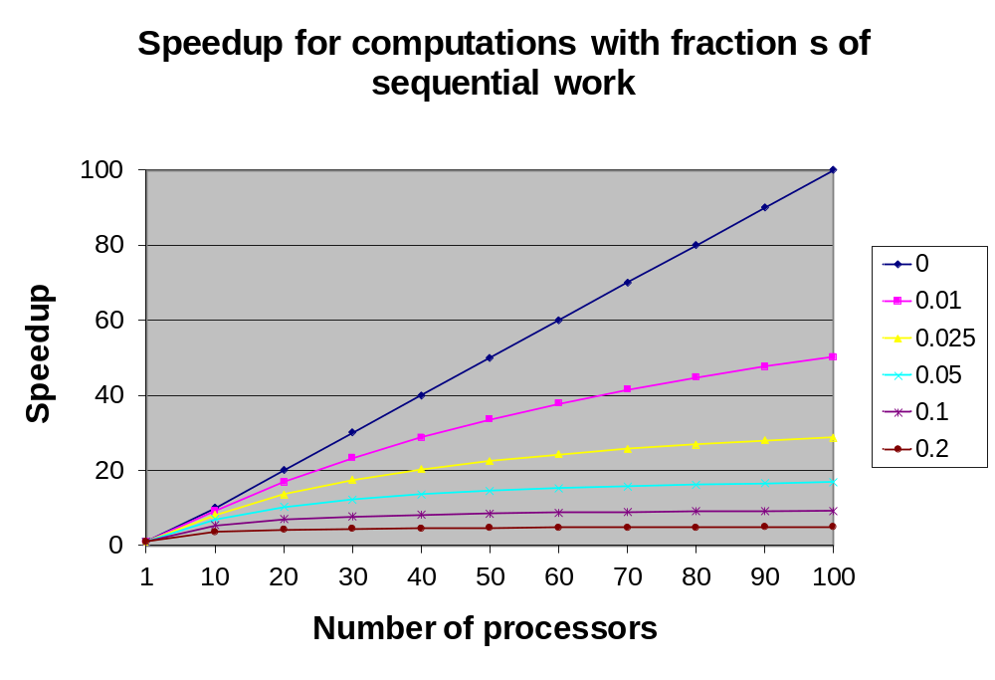
Amdahl’s Law in Theory
S:

Slide 16

Amdahl’s Law in Reality
Speedup doesn’t follow perfect curve in reality.
80
s = 0.01
70
60
50
Amdahl's Law
40
Reality
30
20
10
0
0
50
100
150
200
250
Number of processors

Slide 17
Challenges in Parallel Computing
Parallel software is the problem
Need to get significant performance improvement
  Otherwise, just use a faster uniprocessor, since it’s easier!
Difficulties
  Partitioning
    Balanced workload
    Workload scheduling
  Coordination
    Slowing down program execution
  Communications overhead
    Data exchange
Notes:
Morgan Kaufmann Publishers
Chapter 7 — Multicores, Multiprocessors, and Clusters

Slide 18
Parallelization Not Free
Parallelization creates overhead
Typical sources of overhead
  Inter-process interaction
    Communicating
    Sources: synchronization, data exchange
  Idling
    Waiting
    Sources: load imbalance, synchronization, serialization, resource contention
  Excess computation
    Replicating
    Sources: computation repeated by multiple processes

Slide 19
Parallel Architectures
No single standard parallel architecture used on parallel machines
  dozens of different parallel architectures built and used
Several people have tried to classify the different types of parallel machines
  The taxonomy proposed by Flynn is the most commonly used
Notes:
MSCS282 Parallel Computing

Slide 20
Flynn’s Model of Computation
Any computer, whether sequential or parallel, operates by executing instructions on data
  a stream of instructions (the algorithm) tells the computer what to do
  a stream of data (the input) is affected by these instructions.
Four classes of computers
Notes:
MSCS282 Parallel Computing

Slide 21
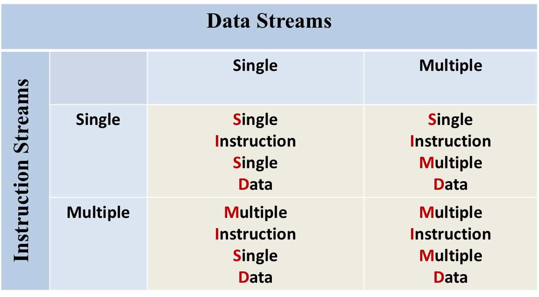
Flynn’s Taxonomy
Notes:
MSCS282 Parallel Computing

Slide 22

SISD Computers
Standard serial computers
  A single processing element receives a single stream of instructions that operate on a single stream of data
  No parallelism here
Notes:
MSCS282 Parallel Computing

Slide 23
SIMD Computers
Multiple processors execute the same program in lockstep
  Processors can be selected (on/off) under program control (mask) at each cycle
  Synchronous
There are N data streams, one per processor
Data that each processor sees may be different
Often referred to as data parallel computing
SIMD relies on the regular structure of computations (such as those in image processing).
Examples: llliac IV, Thinking Machines CM-2, DAP
Notes:
MSCS282 Parallel Computing

Slide 24
SIMD
Controller
PE
PE
PE
PE
Memory
Memory
Memory
…
Memory
Interconnection Network
Notes:
MSCS282 Parallel Computing

Slide 25
MIMD Computers
Most general and most powerful of Flynn’s taxonomy
  N processors
  N streams of instructions
  N streams of data
Each processor executes its own instruction stream
  Capable of executing its own program on a different data
  Processors operate asynchronously
Notes:
MSCS282 Parallel Computing

Slide 26
MIMD Computers
PE
PE
PE
…
PE
PE
PE
PE
PE
Interconnection Network
Memory
Memory
Memory
…
Memory
Memory
Interconnection Network
Shared memory MIMD computers, or multiprocessors.
distributed memory MIMD computers with, or multicomputers, are connected with a high performance network.
Notes:
MSCS282 Parallel Computing

Slide 27
Some More MIMD Computers
Cluster: computers connected over high-bandwidth local area network (usually Ethernet Myrinet, Infiniband), used as a parallel computer.
NOW (Network Of Workstations): homogeneous cluster (all computers on network are same model).
“The Grid”: computers connected over wide area network
Notes:
MSCS282 Parallel Computing

Slide 28
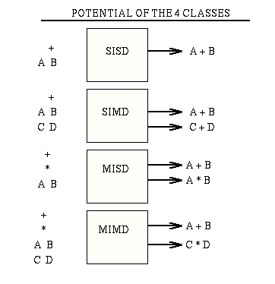
The 4 Classes
x
Notes:
MSCS282 Parallel Computing

Slide 29
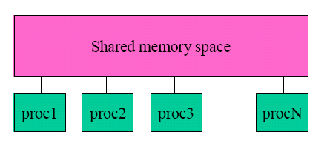
Example Parallel Programming Models and Libraries (I)
Multithreading with Posix Pthreads
  For single machines with single/multiple processors/cores
  Available as a standard set of C library functions
    Headfile: pthread.h
    Link it with -pthread
    60+ functions
OpenMP
  For single machines with multiple cores/processors
  Compiler directives: #pragma omp
  Supported by gcc 4.2 and above
    gcc -fopenmp code.c
    ./a.out

Slide 30
Parallel Programming Example: Sum Reduction
This example is by no means the exact code
  Only the semantics shown
Sum 100,000 numbers on 100 processor UMA
  Each processor has ID: 0 ≤ Pn ≤ 99
  Partition 1000 numbers per processor
  Initial summation on each processor
  sum[Pn] = 0;
  for (i = 1000*Pn;
  i < 1000*(Pn+1); i = i + 1)
  sum[Pn] = sum[Pn] + A[i];
Now need to add these partial sums
  Reduction: divide and conquer
  Half the processors add pairs, then quarter, …
  Need to synchronize between reduction steps
Notes:
Morgan Kaufmann Publishers
Chapter 7 — Multicores, Multiprocessors, and Clusters

Slide 31
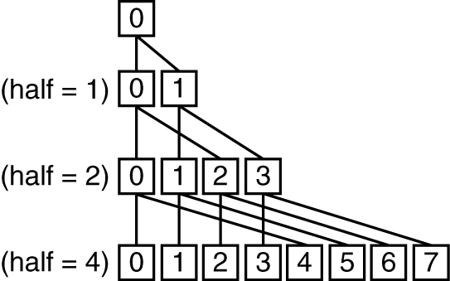
Example: Sum Reduction
half = 100;
repeat
synch();
if (half%2 != 0 && Pn == 0)
sum[0] = sum[0] + sum[half-1];
/* Conditional sum needed when half is odd;
Processor0 gets missing element */
half = half/2; /* dividing line on who sums */
if (Pn < half) sum[Pn] = sum[Pn] + sum[Pn+half];
until (half == 1);
Notes:
Morgan Kaufmann Publishers
Chapter 7 — Multicores, Multiprocessors, and Clusters

Slide 32
Example Parallel Programming Models II
Message Passing Interface (MPI)
  Suitable for computer clusters
  Available on virtually all platforms
CUDA
  Programming for Nvidia Graphics Processing Units
MapReduce
  Originated from Google, suitable for data centers
  Programming for data analytics
    Google, facebook, …
mem1
mem2
mem3
memN
proc1
proc2
proc3
procN
network

Slide 33
Summary
Parallel Computing vs. Sequential Computing
Flinn’s Taxonomy
Example parallel computing platforms and programming

